Slide 1
Algorithm Complexity

Slide 2
Algorithm Complexity
Algorithm complexity theory is a branch of algorithm study that deals with the analysis of algorithms in terms of computational resources such as time space
Computational theory deals with the theoretical issues of solvability of a problem
Algorithm depends upon
Machine speed
Programming language
Efficiency of compiler (language translation)
Input size
Data structure used

Slide 3
Measures for Algorithm Analysis
Measures for algorithm analysis
Subjective measures
(eg. Easy of implementation)
Objective measures
Dynamic objective measures
(eg. Time and space)
Static objective measures
(eg. Program length)

Slide 4
Measures for Algorithm Analysis
Subjective measures
Ease of implementation, algorithm style and understandability of algorithm
differ from person to person or from time to time
Objective measures
Used for performance evaluation
Computing speed, memory requirements, disk usage and network usage
Should be quantifiable, predictive power and inherent simplicity

Slide 5
Measures for Algorithm Analysis
Static objective measures
Do not depend on input instances
Do not change of how many instance of an algorithm are scaled
Eg. Program length and program volume
They are not suitable for algorithm analysis
Dynamic objective measures
Depends on input instance and hence more accurate
Include run time, memory space, catch hit ratio, disk usage and network usage

Slide 6
Time complexity t(n) or T(n)
Time complexity is a measure of how much run time an algorithm requires for execution when the input size is scaled
To determine t(n) or T(n)
To select an appropriate computational model
To find a suitable measuring unit to characterize the algorithm complexity
Implementation of program
Run time or
Execution time
Compiler time

Slide 7
Mathematical analysis
Estimate time complexity
Also called as a priori analysis or theoretical analysis
Performed before the algorithm is translated into a program
Uses step count or operation count
Analysis is independent of programming language or machine environment
Independent of input instance
Preferable for small algorithm
Mathematical knowledge is needed
Not related to software testing

Slide 8
Empirical analysis
Estimate time complexity
Performed after the implementation of an algorithm in the form of a program
Analysis is dependent on programming language or machine environment
Depend on the distribution of inputs
Length of the program is immaterial
Mathematical knowledge is not needed
Related to software testing

Slide 9
Analysis of Iterative Algorithms
Measure the input size
Measure the running time either step count or operation count
In the case of operational count, find worst, best and average case efficiencies of the algorithm
Identify the rate of growth

Slide 10
Measure the input size
Number of binary bits used to represent the input data
Efficiency of an algorithm is always expressed as a function of the input size
Example
Integers
Matrices
Arrays
Graphs

Slide 11
Measure the running time
Step count
Set of instructions of a RAM
Operations count
To find an basic operator and express time complexity in terms of number of times the basic operation are performed
Asymptotic analysis
To illustrate the behaviour of the running time
Recurrence relations
Analysing the recursive program
Amortized analysis
Analyzing a sequence of operations of a data structure

Slide 12
Step Count
Count the number of steps or instruction used by an algorithm
First step to find steps per execution and frequency of statements
Non executable steps 🡪 0 value
Executable steps 🡪 1 value
Eg. Return a 🡪 1 value
Pros and Cons
Evaluation of time complexity is easy
Not dependent on operands
Eg : a = a +5
a = a + 10⁹ have same step count

Slide 13
Step count
Ways to measure step count
Declarative statement
Initialization 🡪 1 count
Without initialization 🡪 0 count
Comments / brackets (begin/end/if/end while/end if) 🡪 0 count
Expression 🡪1 count
Assignment statement, function invocation, return statement and others(break, continue, go to) 🡪 1 count

Slide 14
Step count
Simple (A, B, C)
Begin
A = B + 1
C = A + 2
D = A + B
End
Step number | program | Steps per execution | Frequency | Total
1 | Simple (A, B, C) | 0 | - | -
2 | Begin | 0 | - | -
3 | A = B + 1 | 1 | 1 | 1
4 | C = A + 2 | 1 | 1 | 1
5 | D = A + B | 1 | 1 | 1
6 | End | 0 | - | -
 | Total |  |  | 3

Slide 15
Step count
Sum ( )
Begin
sum = 0
for i=1 to n do
sum = sum +1
End for
return sum
End
Step number | program | Steps per execution | Frequency | Total
1 | Sum () | 0 | - | 0
2 | Begin | 0 | - | 0
3 | sum = 0 | 1 | 1 | 1
4 | for i =1 to n do | 1 | n + 1 | n + 1
5 | Sum = sum + 1 | 1 | n | n
6 | End for | 0 | 0 | 0
7 | Return sum | 1 | 1 | 1
8 | End | 0 | 0 | 0
 | Total |  |  | 2n + 3

Slide 16
Problem
K=1
while k <= N
k = k + 1
End while
Sample ()
Begin
for i= 1 to n
return i
End for
End
Ex ()
Begin
for i = 1 to n
for j = 1 to n
A (i, j) = 0
End for
End for
End
Sum()
Begin
sum = 0.0
for i=1 to n do
val = 2 * i
sum = sum + val
End for
return sum
End
for i=1 to n-1 do
for j = i + 1 to n do
swap (a,b)
End for
End for

Slide 17
Operation Count
Perform algorithm analysis
Count the number of operations instead of steps
Types
Elementary (basic): primitive operations implemented with less effort
Non elementary (non-basic): sorting, maximum or minimum
Steps
Count the number of basic operations of a program and express it as a formula
Simplify the formula
Represent the time complexity

Slide 18
Operation Count
Rules for finding operation count
Sequence
Addition principle
Begin
s1 // m operations
s2 // n operations
End
// requires m + n operations
Selection
If (condition C) then Statement P // m operations for P
Else Statement Q // n operations for Q
If-then-else requires maximum(m, n) operations
Repetition
Multiplication principle
if loop executes a task n times and if the task involves m operations
Operation count = m * n

Slide 19
Operation Count
Step number | program | Operations accounted for | Operation cost | Repetitions | Total
1 | Swap (a, b) | - | 0 | 0 | 0
2 | Begin | - | 0 | 0 | 0
3 | temp = a | Assignment | C1 | 1 | C1
4 | a = b | Assignment | C2 | 1 | C2
5 | b = temp | Assignment | C3 | 1 | C3
6 | End | - | - | - | -
 | Total T(n) |  |  |  | C1 + C2 + C3
Swap (a, b)
Begin
temp = a
a = b
b = temp
End

Slide 20
Operation Count
Sample ()
Begin
for k = 1 to n do
A = A x k
End for
End
Step number | program | Operations accounted for | Operation cost | Repetitions | Total
1 | Sample( ) | - | 0 | 0 | 0
2 | Begin | - | 0 | 0 | 0
3 | for k =1 to n | Assigning, testing, increment | C1 | n + 1 | (n +1) x C1
4 | A = A x k | Perform multiplication | C2 | n | n x C2
5 | End for | - | - | - | -
6 | End | - | - | - | -
 | Total T(n) |  |  |  | (C1 + C2)n + C1 ≈ cn

Slide 21

Problem
Ex ()
Begin
for i = 1 to n do
for j = 1 to n do
A = B x C
End for
End for
End
Step number | program | Operations accounted for | Operation cost | Repetitions | Total
1 | Ex( ) | - | 0 | 0 | 0
2 | Begin | - | 0 | 0 | 0
3 | for i = 1 to n | Assigning, testing, increment | C1 | n + 1 | (n +1) x C1
4 | for j = 1 to n | Assigning, testing, increment | C2 | n(n +1) | n(n +1) x C2
5 | A = A x k | Perform multiplication | C3 | n² | n² x C3
6 | End for | - | - | - | -
7 | End for | - | - | - | -
8 | End | - | - | - | -
 | Total T(n) |  |  |  | C1 + (C1 + C2)n + (C2 + C3) n²

Slide 22
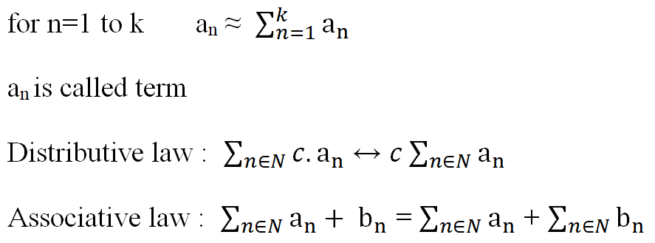
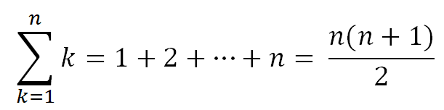
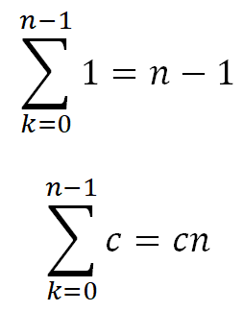
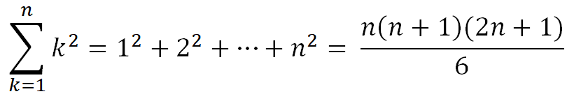
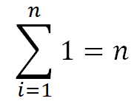
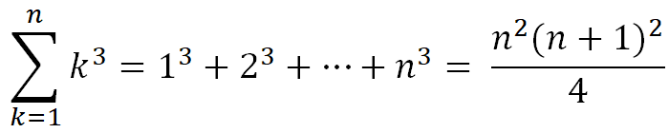
Counting - Formula

Slide 23
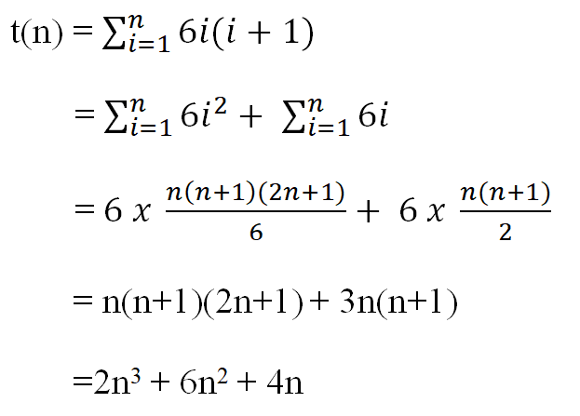
Counting
Let us assume that the analysis of an algorithm yields t(n) as follows. What is the estimate of the total number of operation

Slide 24
Reason for Algorithm Analysis
Time complexity
Polynomial algorithm
2n+3, n²
Easily solvable
Exponential algorithm
n!, 2^{n}
Difficult to solve

Slide 25
Example
Let there be a limit of maximum 5 hours for performing a task. Let there be two algorithm A and B having time complexities T_{A} = n² and T_{B} = 2^{n}. How many inputs can be processed by these two algorithms and which algorithm is efficient?
5 hrs = 18000 sec
n² = 18,000 ↔ n = √18000 = 134 (process 134 inputs)
2^{n} = 18000 ↔ n ≈ 20 (process 20 input)
A is better as it process more inputs

Slide 26
Problem
K=1
while k <= N
k = k + 1
End while
Sample ()
Begin
for i= 1 to n
return i
End for
End
Ex ()
Begin
for i = 1 to n
for j = 1 to n
A (i, j) = 0
End for
End for
End
Sum()
Begin
sum = 0.0
for i=1 to n do
val = 2 * i
sum = sum + val
End for
return sum
End
for i=1 to n-1 do
for j = i + 1 to n do
swap (a,b)
End for
End for

Slide 27






Problem
Estimate of the total number of operation

Slide 28
Best-, Worst- and Average-case Complexity
Efficiency of algorithm depends on input size (n) and distribution of input data
Best-, Worst- and Average-case efficiency of algorithm can be estimated by different distribution of input data

Slide 29
Worst – Case complexity and upper bound
The worst case efficiency considers the maximum number of times the basic operation is executed.
Upper bound of the algorithm
Cause a computer to run slower
Algorithm needs to perform maximum number of steps or operations to process the input
W(n)- worst case time complexity analysis/ upper bound
W(n) = max_{1<i<k} {T_{i}(k)}

Slide 30
Best – Case complexity and lower bound
Best case time complexity analysis is the determination of the smallest number of times the basic operation is done.
Lower bound of the algorithm
Minimum computation time of the algorithm
Algorithm needs to perform minimum number of steps or operations to process the input
B(n) - best-case time complexity analysis / lower bound
B(n) = min_{1<i<k} {T_{i}(k)}

Slide 31

Average – Case complexity
The average or Expected value of the number of times the algorithm does the basic operation for an input size of n.
A(n) - average-case complexity
The input is random and provide prediction about the running time of an algorithm
To compute A(n), we need to assign probabilities to all possible inputs of size n.

Slide 32
Example
Linear Search
W(n) = n (last element or element not found)
B(n) = 1 (first element)
A(n) = items can be present anywhere in the list
p = 1/n (probability of presence of item)
= 1. 1/n + 2. 1/n + ………..+ n. 1/n
= 1/n(1+2+…+n)
= 1/n(n.(n+1)/2)
= (n+1)/2
A(n) = n

Slide 33


Example
Algorithm (Insertion Sort) Cost operation count
for j=2 to A. length c1 n
{
key = A[j] c2 n-1
i = j-1 c3 n-1
while i>0 & a[i]>key c4
{
A[i+1] = A[i] c5
i = i+1 c6
}
A[i+1] =key c7 n-1
}

Slide 34


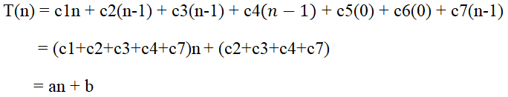
Example
Best Case : B(n) = = 1
Algorithm (Insertion Sort) Cost operation count
for j=2 to A. length c1 n
{
key = A[j] c2 n-1
i = j-1 c3 n-1
while i>0 & a[i]>key c4
{
A[i+1] = A[i] c5
i = i+1 c6
}
A[i+1] =key c7 n-1
}

Slide 35


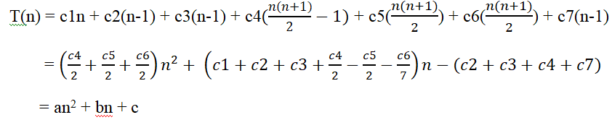
Example
Worst Case :
Algorithm (Insertion Sort) Cost operation count
for j=2 to A. length c1 n
{
key = A[j] c2 n-1
i = j-1 c3 n-1
while i>0 & a[i]>key c4
{
A[i+1] = A[i] c5
i = i+1 c6
}
A[i+1] =key c7 n-1
}

Slide 36
Rate of Growth
Find the behaviour of an algorithm
Measure the complexity of an algorithm t(n) for larger values of n
Compare it with the collection of functions that have the same growth rate so that the algorithm can be classified and ranked
1 < log n < √n < n < n logn < n² < n³ < ……………< 2^{n} < 3^{n} < …. <n^{n}

Slide 37
Function Name | Name used | Remark
c | Constant algorithm | These algorithm are independent of the input
log log N | Log log function | Logarithmic algorithm are preferred, as their growth is always low
log N | Logarithmic | These are very optimal algorithms
log² N | Log- Squared | These are optimal algorithms
N | Linear algorithm | Linear algorithms are preferred, e.g. summing of an array
N log N | N-Log- N | Many popular algorithms like merge sort have this type of growth
N² | Quadratic | Sorting algorithm are preferred. Eg. Bubble sort, selection sort
N³ | Cubic | Matrix multiplication is preferred
N^{k} | Polynomial | Polynomial algorithms of lesser order k are preferred
a^{n} | Exponential | Here a is a constant, and intractable algorithms are exponential
N! | Factorial | These algorithms are intractable

